Slide 1
Modeling Video Watch Time with Exponential–Gaussian Mixtures
Zach Xie
Notes:
Today I’ll walk through a RecSys 2025 paper from Xiaohongshu about predicting video watch time. The twist: instead of predicting a single number, they model the whole distribution of how long users watch.

Slide 2
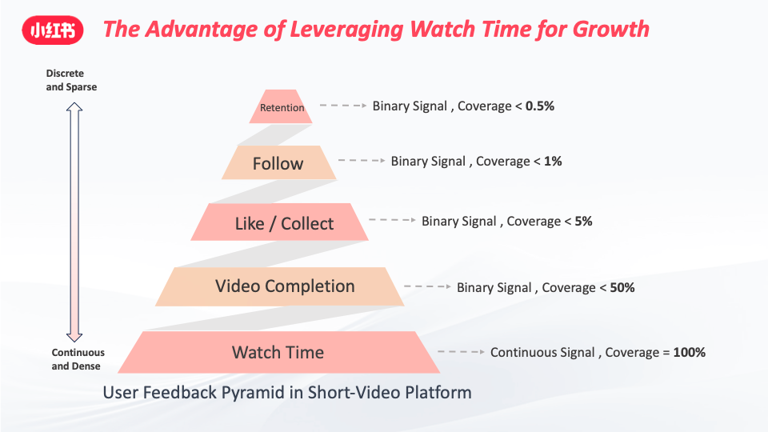
Why Watch Time Matters?
Short-video platforms live on watch time (engagement, DAU).
Ranking models often optimize expected watch time.
Better prediction→better feeds, retention, monetization.
Notes:
In feeds like TikTok, Reels, or Xiaohongshu, watch time is the core signal: if you don’t watch, the content doesn’t matter. So the ranking model needs to accurately predict how long you’ll stay on each video.

Slide 3
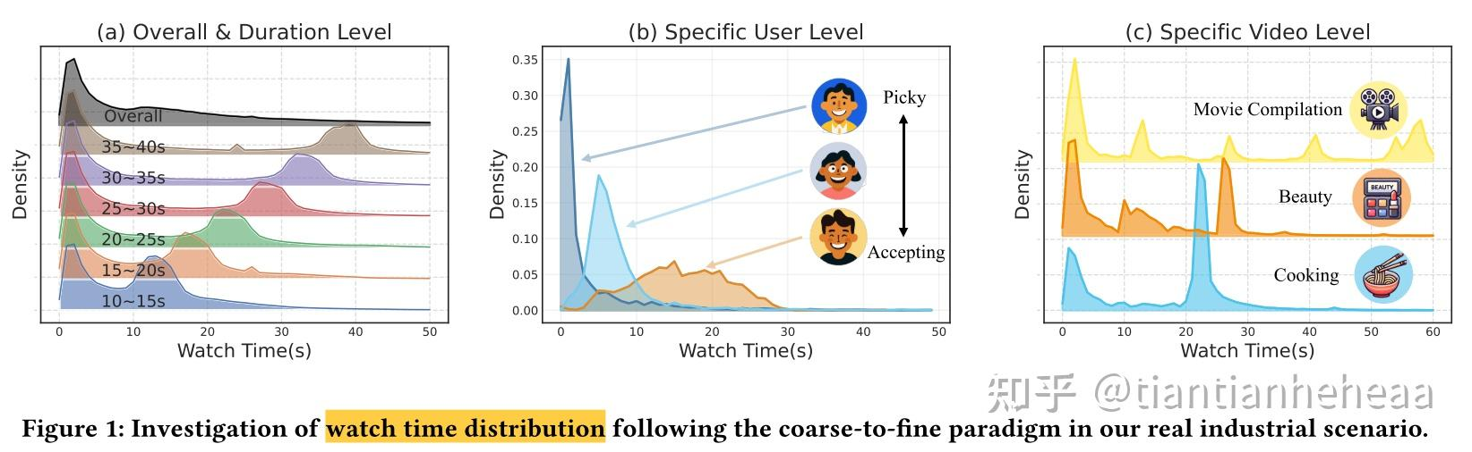
Watch Time: Not a Bell Curve
Huge spike near 0 seconds: many users swipe immediately (“quick-skips”)
Long tail for users who stay longer.
Distribution is heavily skewed and multi-modal.
Notes:
Real watch time data is ugly: tons of quick skips at ~0 seconds, then a long tail for people who stay. It’s nowhere near Gaussian.

Slide 4
Multi-Granularity Watch Time Patterns
By duration: short vs long videos show bimodal patterns (skip vs full watch).
Per user: some users bail early, others watch longer.
Per video: different engagement shapes (bimodal, multi-peak, near-full views).
→ Need a model that works from global down to user–video level.
Notes:
At different levels—global, by video length, by user, and by individual video—you see very different shapes. A single simple distribution is not enough.

Slide 5
Why Standard Approaches Fall Short
Regression: predict one number (MSE / MAE).
Classification: bucket watch time into intervals.
Pairwise ranking: compare videos by watch time.
Different distributions can share the same mean; quick skips not treated specially.
Notes:
If you only predict a single number, you can’t distinguish between ‘half the users love it, half hate it’ and ‘everyone kind of likes it’. Same mean, very different behavior.

Slide 6
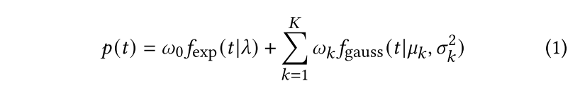
Exponential–Gaussian Mixture
Exponential component: captures quick skips near 0 seconds.
Gaussian mixture: captures richer, possibly multi-peak viewing patterns.
Mixture weights and parameters depend on user, video, and context.
Notes:
The key idea: factor out quick skips with an exponential, then use a Gaussian mixture to handle more complex viewing behavior.

Slide 7
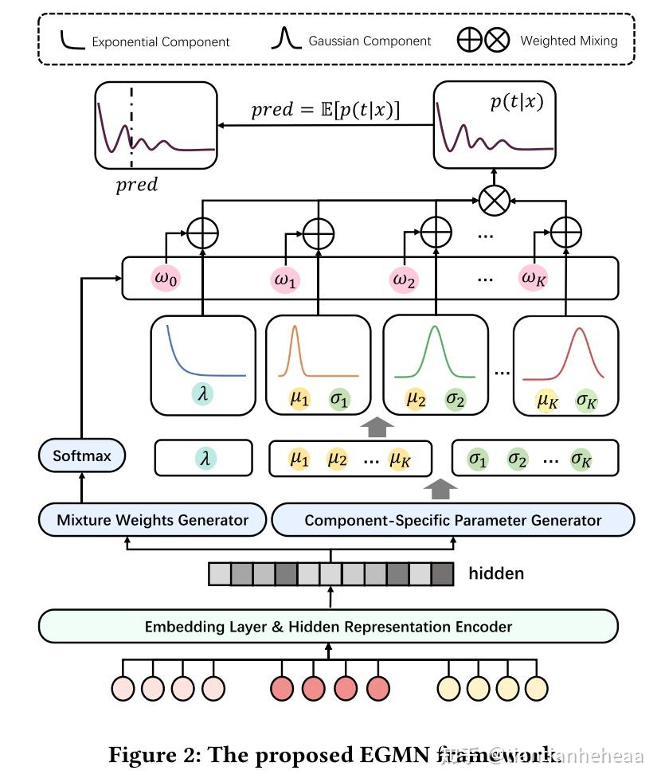

Slide 8
Exponential–Gaussian Mixture Network (EGMN)
Inputs: user, video, and context features.
Shared encoder produces a hidden representation h.
Heads from h predict: λ (exp. rate), μk (means), σk² (variances), and mixture weights.
From the mixture, compute expected watch time for ranking.
Notes:
EGMN is essentially a distribution head on top of any recommender backbone. The backbone gives a shared representation; then four small heads output the mixture parameters.

Slide 9
Learning the Distribution and the Mean
Maximum Likelihood Estimation (MLE): fit the full distribution p(t | x).
Entropy regularization: avoid collapsing into single model.
Regression loss on E[t | x]: keep the mean prediction accurate.
Final loss: MLE + α · Entropy + β · Regression.
Notes:
They don’t just chase pretty distributions. The model has to both describe the shape of watch time and also get the expected watch time right.

Slide 10
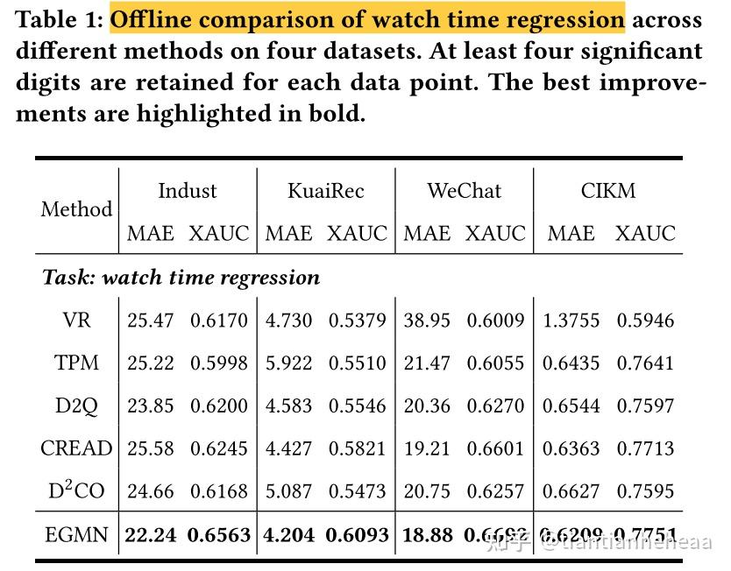
Offline Experiments
Metrics: MAE (accuracy), XAUC (ranking), KL divergence (distribution fit).
Baselines: strong watch-time and continuous-label models (VR, TPM, D2Q, CREAD, etc.).
Notes:
They test on one big in-house dataset plus public ones, and compare against specialized watch-time and distribution baselines, not just a vanilla MLP.

Slide 11
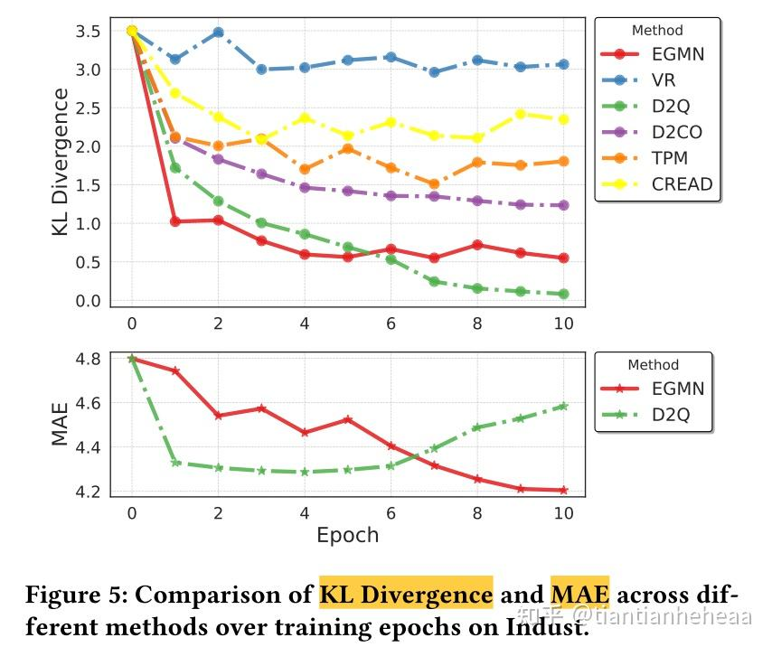

Slide 12
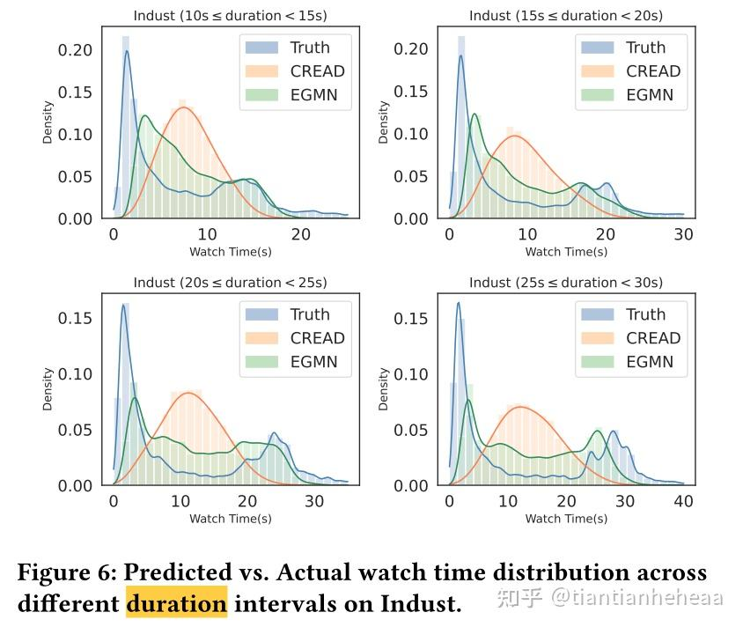

Slide 13
Takeaways
Application:
A continuous target (duration, spend, value)
Heavy skew near zero
Complex multi-modal patterns
Instead of forcing a complex real-world label into a simplistic Gaussian regression setup, let the data’s distribution shape your model design.
Notes:
The exponential bit makes the model very good at classifying quick skips. And at multiple scales, EGMN’s predicted distributions look closer to the ground truth than competitors.

Slide 14
Key Takeaways
Watch time is skewed and multi-modal; simple regression is not enough.
EGMN = Exponential (quick skips) + Gaussian mixture (richer behavior).
Neural network predicts full mixture parameters conditioned on features.
Tri-part loss → good distribution shape and good mean prediction.
Pattern generalizes to other skewed continuous labels (e-commerce, ads, dwell time).
Notes:
If you remember one thing: modeling the distribution of a continuous label can be more powerful than just predicting its mean, especially with many near-zero values.

